Slide 1

"Fuel Consumption Trends in the US: A Data Analysis"
Fundamentals of machine learning
Final project
Gayathri Yenigalla

Slide 2

ProbleM
In order to do our study, we will take information from Schedule 2, Part A of the EIA-923 form. The fuel generation and importation in the US are covered by this dataset.
Based on our observations, we can say that a sizable share of petroleum is imported into the country and that fuel prices are frequently out of line with market rates. This is a major worry given the significance of economic stability in the US.
I'll be focusing more on the categorical data than the numerical variables for this presentation.

Slide 3
Informational overview
The file that was provided is clear and contains no duplicate data; any missing values are null.
The numbers paint a clear picture of the fuel source and mine as well.
It is easier to grasp the data in random smaller versions, thus we will now separate the data into samples.

Slide 4
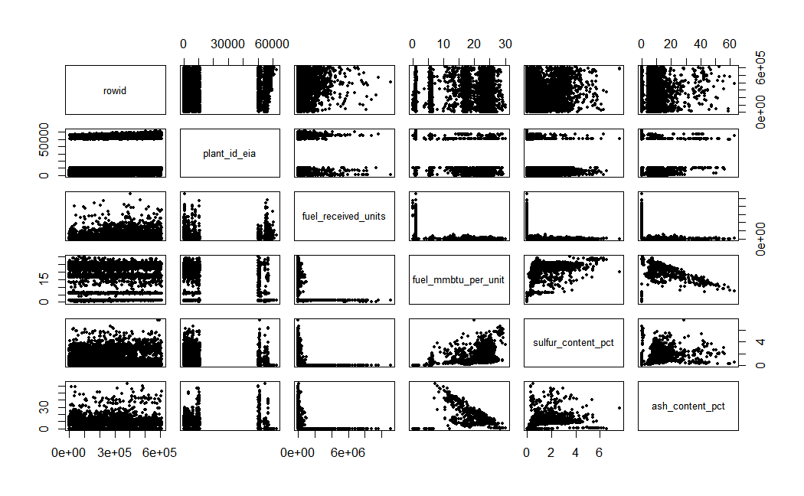
Analysis
I noticed the following scattering in the numerical data with the provided fuel import and usage ratio.
A significant important observation in the cluster formation in my observation has been the data's ash content.
I used the z-score method to normalize the data and identify clusters, but because categorical analysis is more heavily weighted, I believe a theory-based approach is more appropriate for analyzing the impact of fuel imports and exports on the environment.

Slide 5
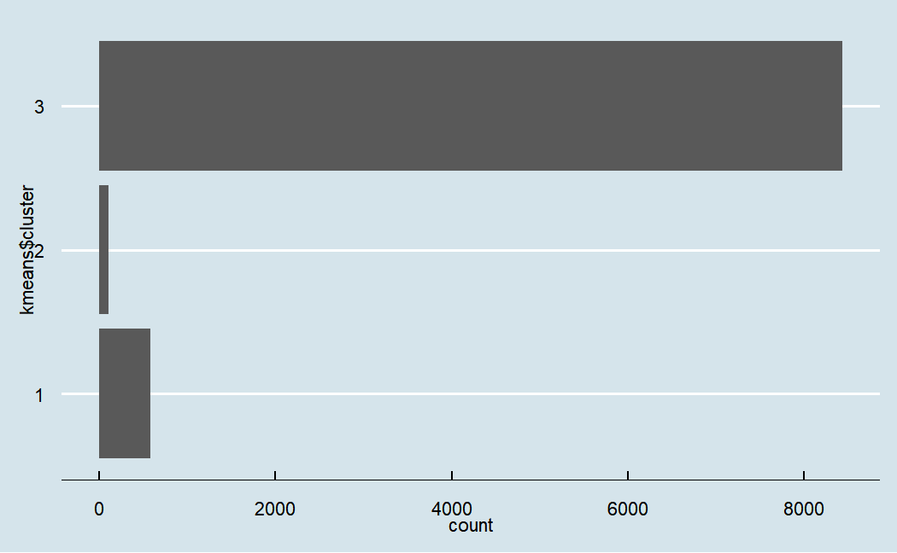
Discussion
As the ash content in fuel per million BTU represents the incombustible component left over after a sample of furnace oil has been completely burned, I have analyzed the data using this measurement.
Less volatile stuff is present in the specified amount of fuel when the ash concentration is high.
It is crucial to determine the amount of fuel that is combustible that was produced.
We can observe that the data is divided into three groups based on their distance and the amount of ash they contain.

Slide 6

CONCLUSION
To sum up, even if renewable energy sources are crucial to our future, it is crucial to understand that they still rely on fossil fuels to produce necessary minerals. Therefore, cutting down on energy use is essential to minimizing the expenses and negative effects of fuel use on the environment. Energy conservation and efficiency can help us move toward a more just and sustainable energy future.

